Slide 1
GNNs: Overview

Slide 2
Outline
1). The function space of GNNs
2). The basics of GNNs
3). Applications

Slide 3
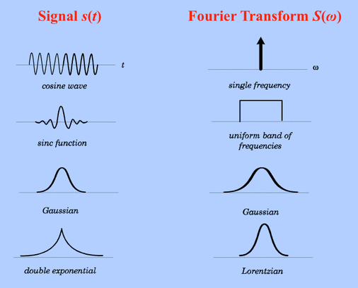
Signal Processing
• A signal in time (length N),
Can be represented by a discrete vector,
https://mriquestions.com/fourier-transform-ft.html

Slide 4
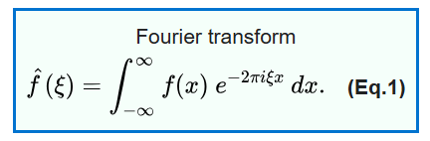
Signal Processing
• A signal in time (length N),
Can be represented by a discrete vector,
wikipedia
https://mriquestions.com/fourier-transform-ft.html

Slide 5
Signal Processing
• A signal in time (length N),
Can be represented by a discrete vector,
wikipedia
• Or instead, as a set of N discrete
Fourier transform coefficients,
https://mriquestions.com/fourier-transform-ft.html

Slide 6
Advantages of FFT representation
• Each coefficient, has some “global” knowledge of
• Most real world signals are “bandlimited” – so coefficients control most of variance

Slide 7
Advantages of FFT representation
• Each coefficient, has some “global” knowledge of
• Most real world signals are “bandlimited” – so coefficients control most of variance
• The basis of FFT is ordered, from low to high frequency

Slide 8
Assumption of FFT
• The “basis” we decompose with is harmonic in time
• Adjacent points in time should behave “similarly”

Slide 9
Assumption of FFT
• The “basis” we decompose with is harmonic in time
• Adjacent points in time should behave “similarly”
• Large difference between nearby points implies: high energy signal, non-smooth, high frequency, etc.

Slide 10
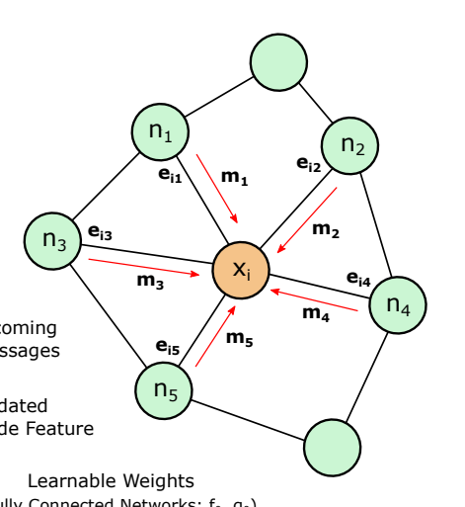
Graph Signal Processing
• How do we represent data on a graph?
Vertex (or node) set
Edge set (or Adjacency matrix)

Slide 11
Graph Signal Processing
• How do we represent data on a graph?
• On one hand, it is just
For graph
Vertex (or node) set
Edge set (or Adjacency matrix)

Slide 12
Graph Signal Processing
• How do we represent data on a graph?
• On one hand, it is just
For graph
Problem
• This makes no use of edges (structure)
• Cant use FFT directly, since now “adjacent points” are no longer linearly ordered
Vertex (or node) set
Edge set (or Adjacency matrix)

Slide 13
Graph Signal Processing: Graph FFT
• Any graph
Has an intrinsic (orthonormal) basis
Vertex (or node) set
Edge set (or Adjacency matrix)

Slide 14
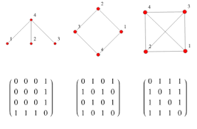
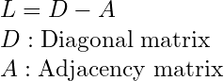
Graph Signal Processing: Graph FFT
• Any graph
Has an intrinsic (orthonormal) basis
wolfram
adjacencies
Vertex (or node) set
Edge set (or Adjacency matrix)

Slide 15
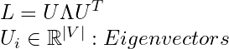
Graph Signal Processing: Graph FFT
• Any graph
Has an intrinsic (orthonormal) basis
wolfram
adjacencies
Vertex (or node) set
Edge set (or Adjacency matrix)

Slide 16
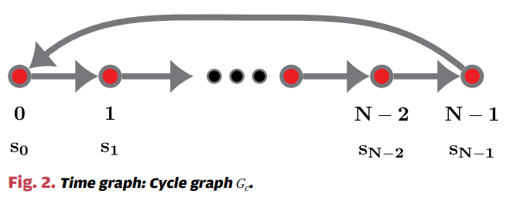
Graph FFT Basis
Vertex (or node) set
Edge set (or Adjacency matrix)
Ortega et a., 2018

Slide 17
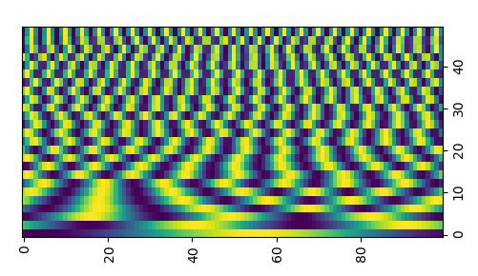
Graph FFT Basis
Vertex (or node) set
Edge set (or Adjacency matrix)
Eigenvector dim
Node dim
Ortega et a., 2018

Slide 18
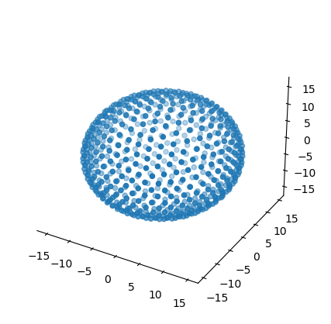
Graph FFT Basis
Vertex (or node) set
Edge set (or Adjacency matrix)
Eigenvector dim
Node dim
Ortega et a., 2018

Slide 19
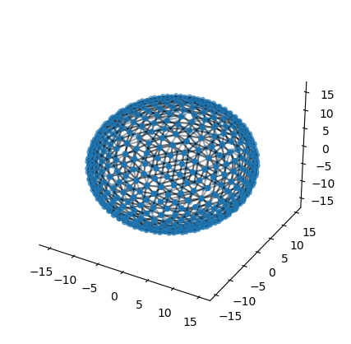
Graph FFT Basis
Vertex (or node) set
Edge set (or Adjacency matrix)
Eigenvector dim
Node dim
Ortega et a., 2018

Slide 20
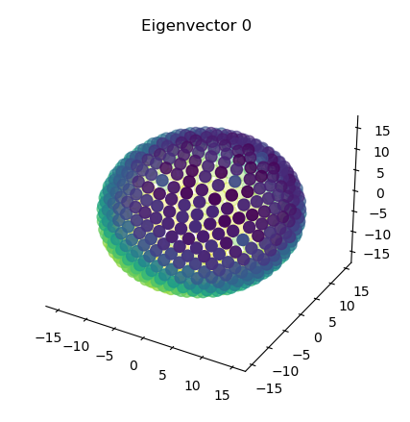
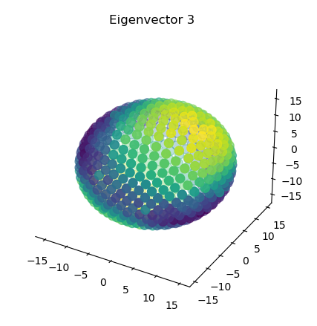
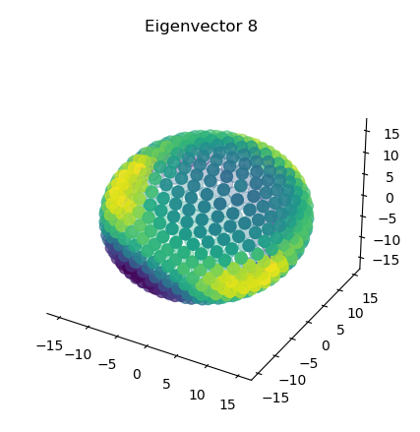
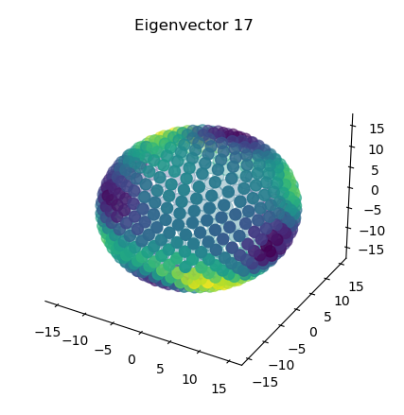
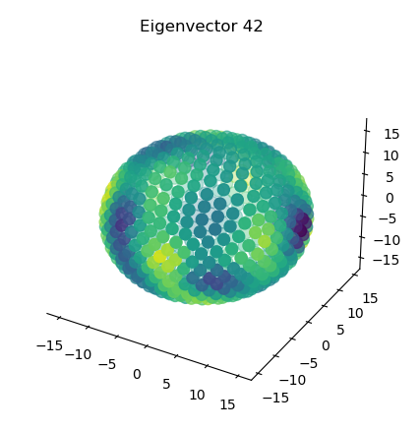
Graph FFT Basis
Vertex (or node) set
Edge set (or Adjacency matrix)
Eigenvector dim
Node dim
Low to high
frequency
Ortega et a., 2018

Slide 21
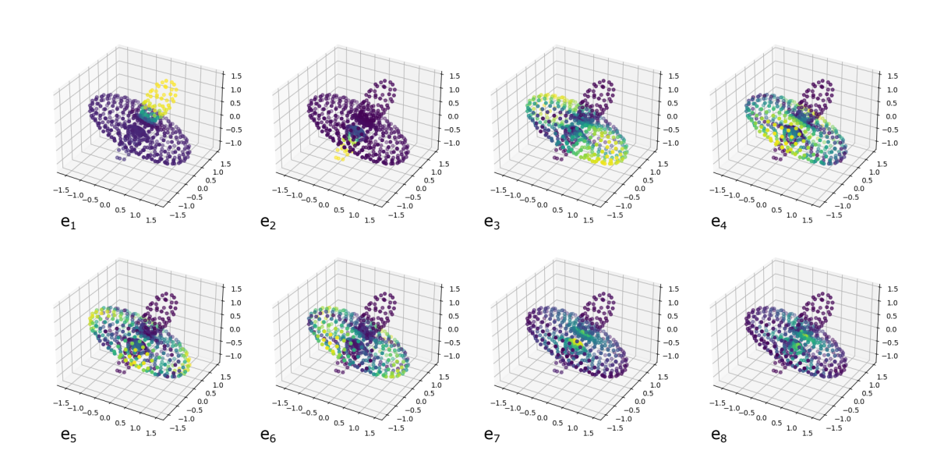
Graph FFT Basis
Vertex (or node) set
Edge set (or Adjacency matrix)
Deformed sphere:
Low to high
frequency
And structure aware

Slide 22
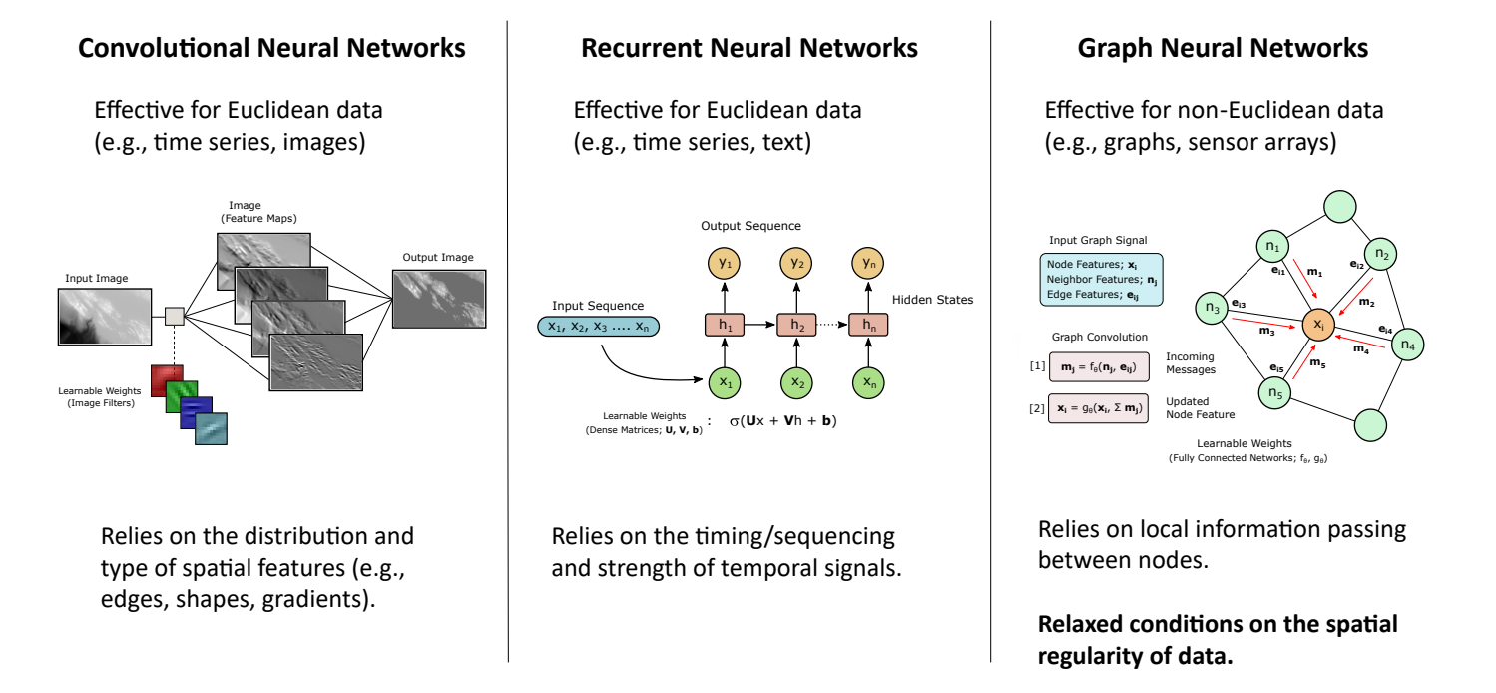
Why Graph Neural Networks?
• CNN’s let us “learn” mappings on regular grid domains
Recall convolution theorem:

Slide 23
Why Graph Neural Networks?
• CNN’s let us “learn” mappings on regular grid domains
Recall convolution theorem:
• Assumption: multiple layers of “convolution” permits
functions that are expressible with ~low order frequency content in Fourier basis

Slide 24
Why Graph Neural Networks?
Graph convolution:
• Rather than using eigenvectors directly (global FFT representation),
Use local message passing (local representation)

Slide 25
Why Graph Neural Networks?
Graph convolution:
• Rather than using eigenvectors directly (global FFT representation),
Use local message passing (local representation)
• After several rounds of message passing, will have “access” to functions supported by graph Laplacian eigenvector basis

Slide 26
Why Graph Neural Networks?

Slide 27
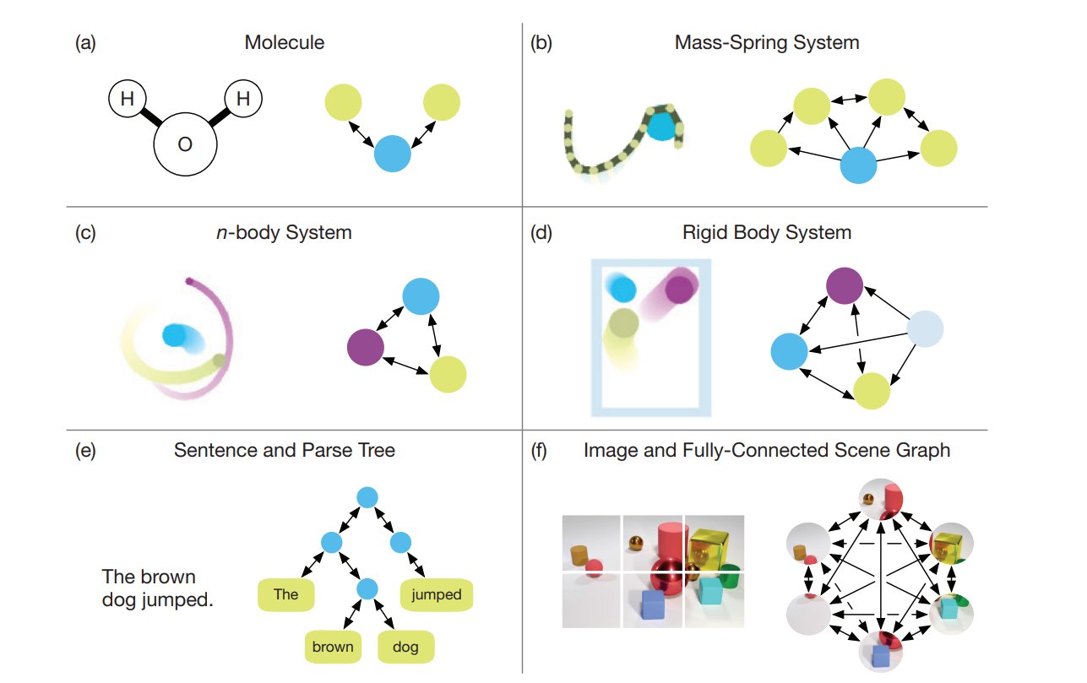
Graph Examples
Common examples:
Sensor networks, social networks, smooth irregular surfaces
Less common examples:
Molecules, multi-particle simulation, sparse matrices, etc.
Battagilia, et al., 2018

Slide 28
Graph Neural Networks
• Technically, could choose fixed “filters” to apply for graph convolution, but would be hard to hand engineer
• Rather, it’s easier to “learn” filters, and process data in a higher-dimensional (lifted) space

Slide 29
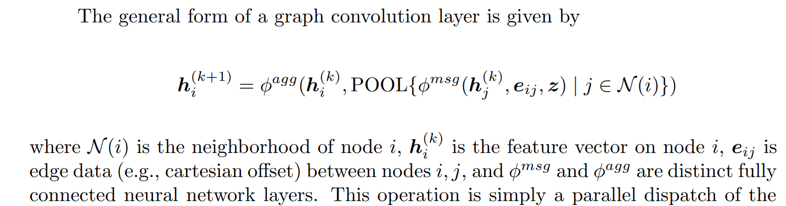
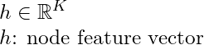
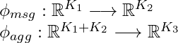
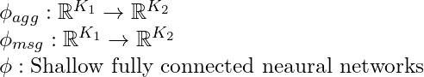
Graph Neural Networks
Message Passing:
Node and edge features:
Learnable weights:

Slide 30
Graph Neural Networks
Message Passing:
(1). For each node i, “collect” all neighboring nodes of node i
(2). Transform each neighboring latent vectors by phi_msg
(3). POOL (mean, max, or sum pool) over node dimension
(4). Concatenate with latent vector of node i from previous layer
(5). Transform concatenated vector with phi_agg

Slide 31
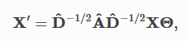
GNN: Properties
Message Passing:
(GCN; Kipf and Welling, 2016)
• Can also be expressed in matrix notation using Adjacency, but this limits perspective and extensions

Slide 32
GNN: Properties
Message Passing:
• Information transfers locally, but expands to further “hops” away with every convolution layer
• Can handle very large, sparse graphs well

Slide 33
GNN: Properties
Message Passing:
• Information transfers locally, but expands to further “hops” away with every convolution layer
• Can handle very large, sparse graphs well
• At each layer of GNN, all nodes features vectors, , are updated based on self, and neighbors

Slide 34
GNN: Properties
Message Passing:
• Information transfers locally, but expands to further “hops” away with every convolution layer
• Can handle very large, sparse graphs well
• Both the features and graph structure have to be used to guide learned function

Slide 35
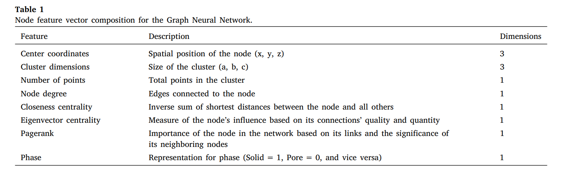
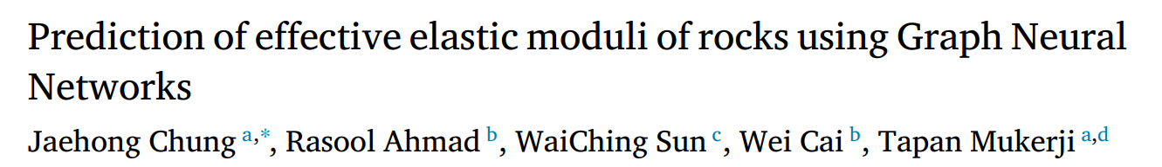
GNN: Properties
Message Passing:
• Both the features and graph structure have to be used to guide learned function

Slide 36
GNN: Properties
Message Passing:
• The graph structure can be the feature

Slide 37
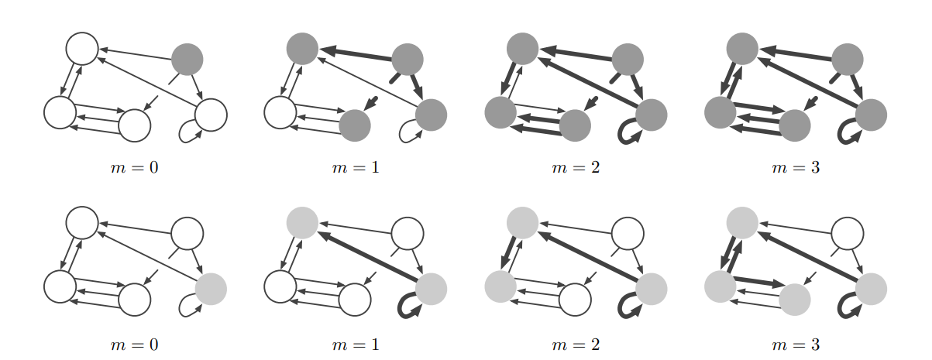
GNN: Properties
Message Passing:
• Information transfers locally, but expands to further “hops” away with every convolution layer
Battagilia, et al., 2018

Slide 38
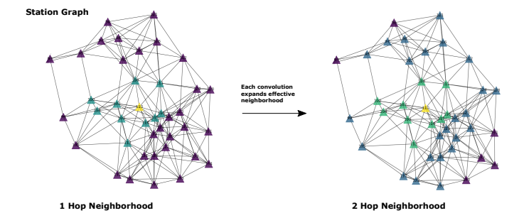
GNN: Properties
Message Passing:

Slide 39
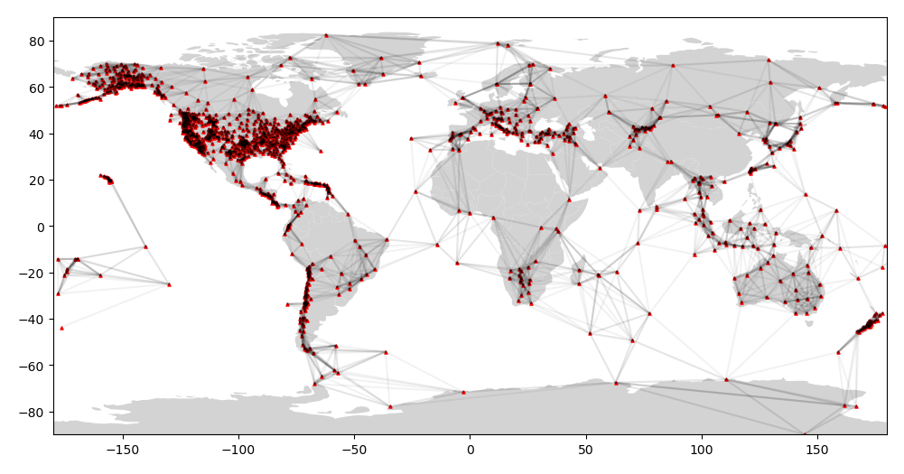
GNN: Considerations
1). Diameter of graph
(longest, shortest path distance; e.g.,
Distance between most separated nodes)

Slide 40
GNN: Considerations
1). Diameter of graph
(longest, shortest path distance; e.g.,
Distance between most separated nodes)
If long-range interactions needed, many ideas proposed:
(i). Add “virtual nodes” connected to all nodes, (ii). Use global summary features, (iii). Add more edges to adjacency (e.g., expander graphs), (iv). Create multi-scale, multi-resolution graphs…

Slide 41
GNN: Considerations
2). Edge features
(Offset vectors between adjacent nodes can be used to infer local curvature)

Slide 42
GNN: Considerations
2). Edge features
(Offset vectors between adjacent nodes can be used to infer local curvature)

Slide 43
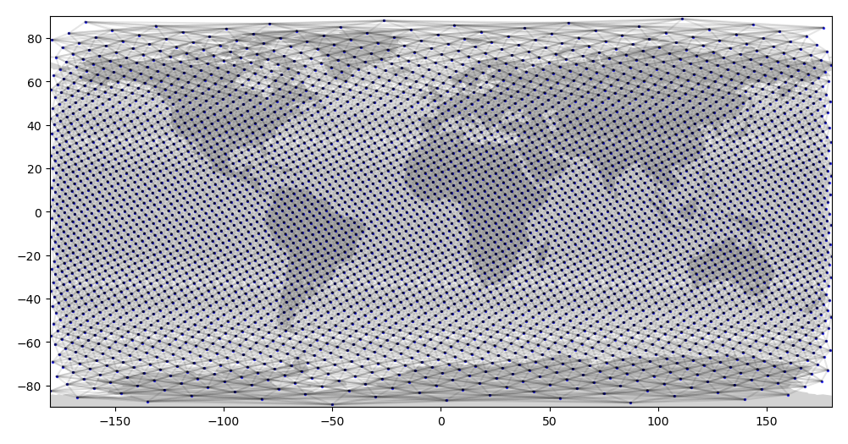
GNN: Considerations
3). Absolute node positions and extra features
“Position aware GNNs” (You et al., 2019) – nodes “know” absolute position
“Identity aware GNNs” (You et al., 2021) – nodes “know” their unique type; access different learnable GNN message passing functions

Slide 44
GNN: Limitations
1). Over-smoothing : Since message passing iteratively shares information, it roughly emulates a diffusion/smoothing process.
To keep discriminative ability of nodes of deep GNNs, “residual” connections necessary (Hamilton et al., 2017)

Slide 45
GNN: Limitations
1). Over-smoothing : Since message passing iteratively shares information, it roughly emulates a diffusion/smoothing process.
To keep discriminative ability of nodes of deep GNNs, “residual” connections necessary (Hamilton et al., 2017)
Node and edge features:
Learnable weights:

Slide 46
GNN: Limitations
1). Over-smoothing : Since message passing iteratively shares information, it roughly emulates a diffusion/smoothing process.
To keep discriminative ability of nodes of deep GNNs, “residual” connections necessary (Hamilton et al., 2017)
2). Over-squashing: A large “volume” of messages is slowly aggregated into a fixed size representation latent vector, which limits expressiveness of representation. Long-range interactions are weak.
Can improve performance with more well-interconnected (sparse) graphs, e.g., expander graphs.

Slide 47
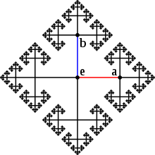
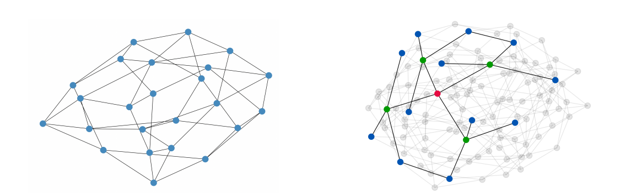
GNN: Limitations
2). Over-squashing: A large “volume” of messages is slowly aggregated into a fixed size representation latent vector, which limits expressiveness of representation. Long-range interactions are weak.
Can improve performance with more well-interconnected (sparse) graphs, e.g., expander graphs.
Deac et al., 2022; “Expander Graph Propagation”
Cayley graphs, wikipedia

Slide 48
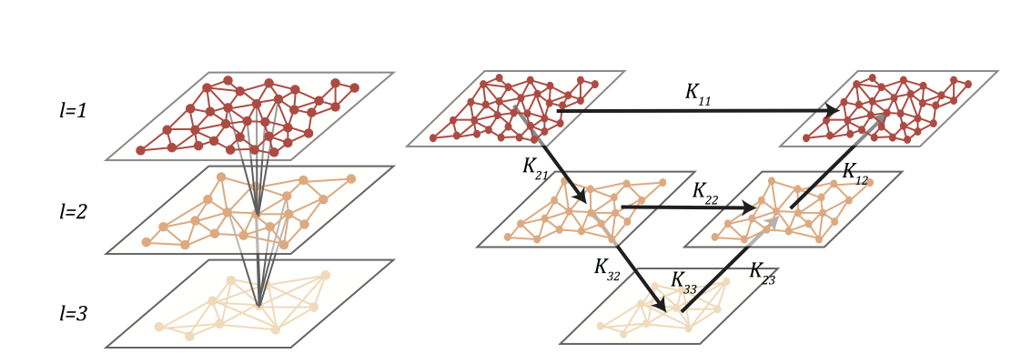
GNN: Limitations
2). Over-squashing: A large “volume” of messages is slowly aggregated into a fixed size representation latent vector, which limits expressiveness of representation. Long-range interactions are weak.
Li et al., 2020; “Multipole Graph Neural Operator”
Hierarchical GNNs

Slide 49
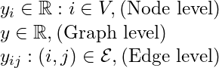
GNN: Setup
[1]. Choose GNN architecture
(number of layers, latent dimension of features,
Edge features available).
[4]. Choose training data
(i.e., synthesize data, graph, and label pairs)
The graph and input features typically both vary for each input
[2]. Choose input field,
[3]. Choose label targets
(either: node-level, graph-level, edge-level predictions)

Slide 50
GNN: Setup
[1]. Choose GNN architecture
(number of layers, latent dimension of features,
Edge features available).
[4]. Choose training data
(i.e., synthesize data, graph, and label pairs)
The graph and input features typically both vary for each input
[2]. Choose input field,
[3]. Choose label targets
(either: node-level, graph-level, edge-level predictions)

Slide 51
GNN: Limitations
1). Diameter of graph
(longest, shortest path distance; e.g.,
Distance between most separated nodes)
2). Over-smoothing : Since message passing iteratively shares information, it roughly emulates a diffusion/smoothing process.
3). Over-squashing: A large “volume” of messages is slowly aggregated into a fixed size representation latent vector, which limits expressiveness of representation. Long-range interactions are weak.

Slide 52
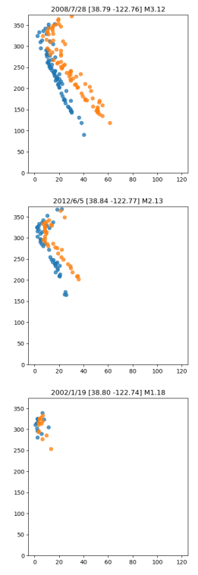
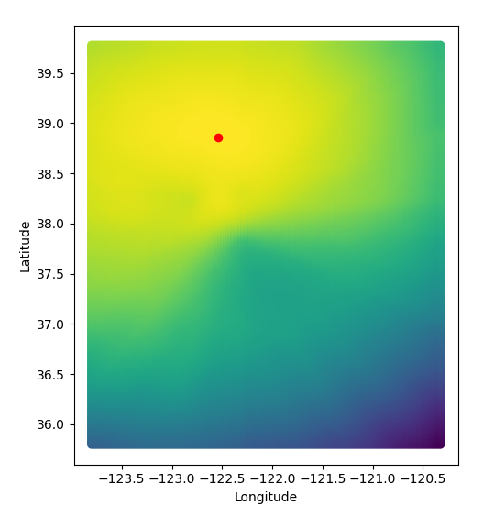
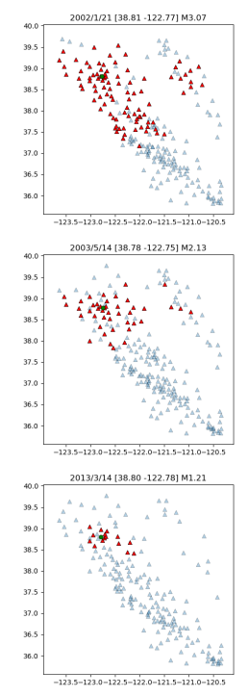
Application: Earthquake Location
Maximum likelihood location
Inversion
Station Index
Time (s)

Slide 53
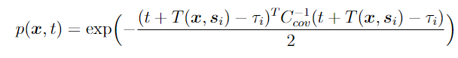
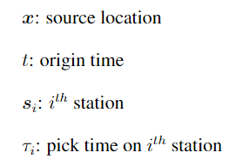
Application: Earthquake Location
Maximum likelihood location
Inversion
Station Index
Maximize posterior probability
Time (s)

Slide 54
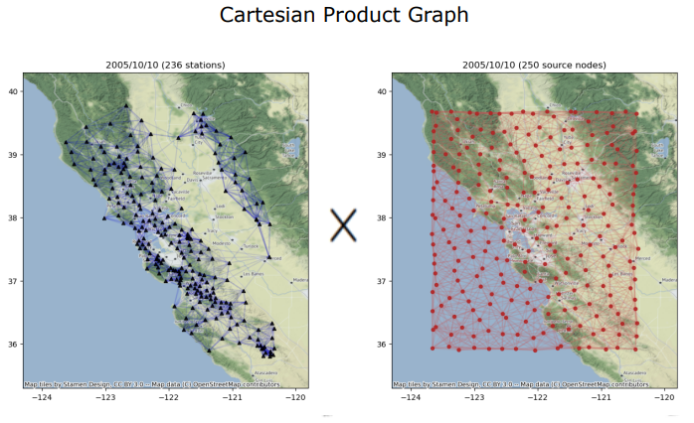
Input Graphs
Station Graph
Spatial Graph
8-nearest-neighbors
15-nearest-neighbors

Slide 55
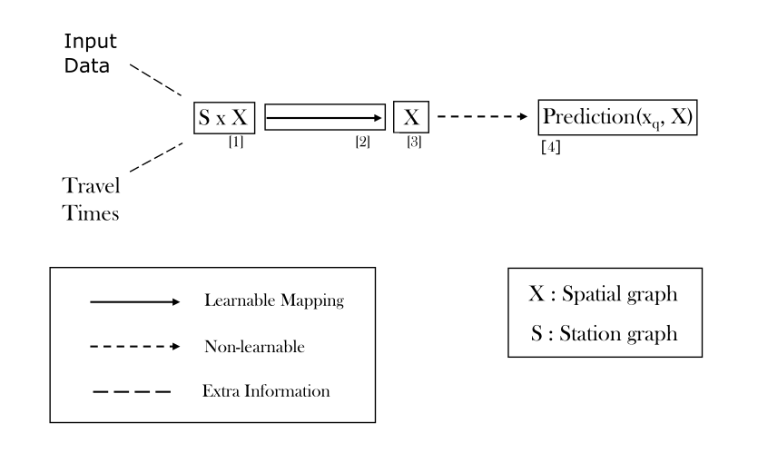
GNN: Architecture

Slide 56
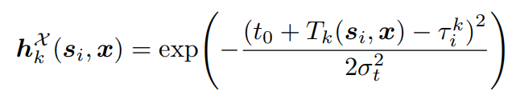
GNN: Architecture
Input feature:
pre-stack BP metric

Slide 57
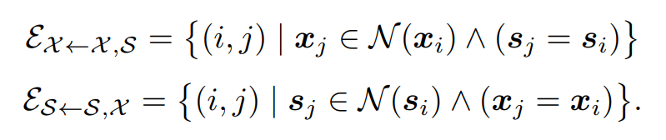
GNN: Architecture
Cartesian Product graph:
Nodes: all pairs of (s,x)
Edges:

Slide 58
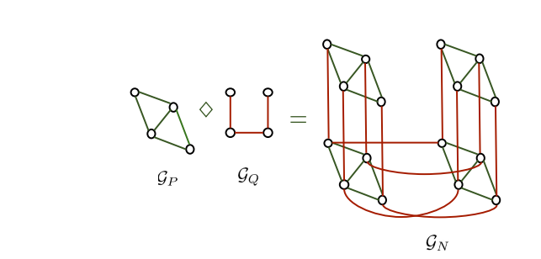
GNN: Architecture
Cartesian Product graph:
Nodes: all pairs of (s,x)
Edges:
• Cartesian product, Kronecker product,
Strong product, Lexicographic product…
Kadambari et al., 2021

Slide 59
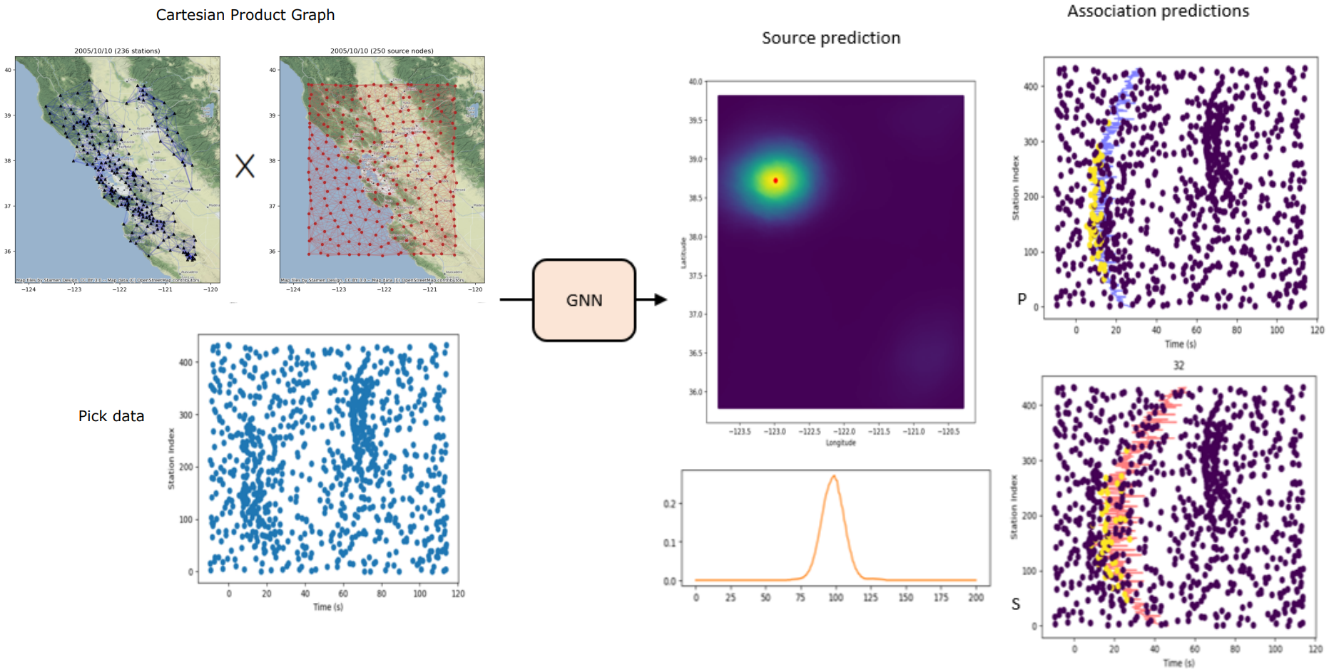
Forward Map

Slide 60
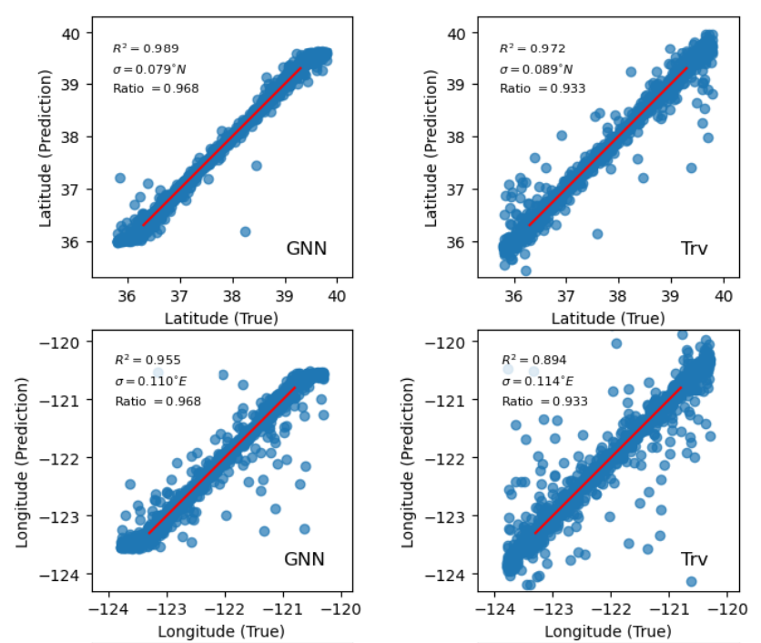
Results on Synthetic Data
Simulated many realizations
of pick data for sources (and different sets of stations)
over large spatial aperture,
with high levels of noise
GNN predicted source locations
Improve upon locations obtained
with traditional inversion

Slide 61
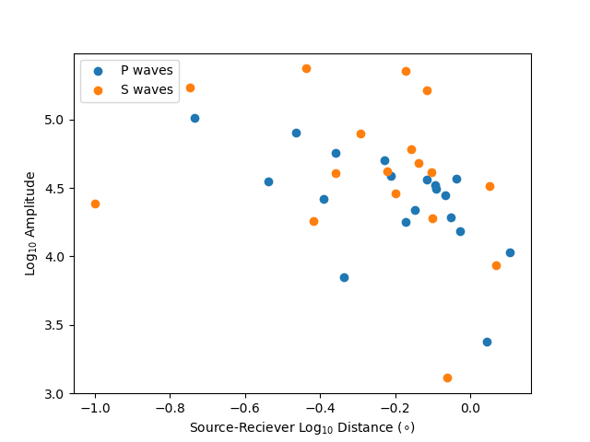
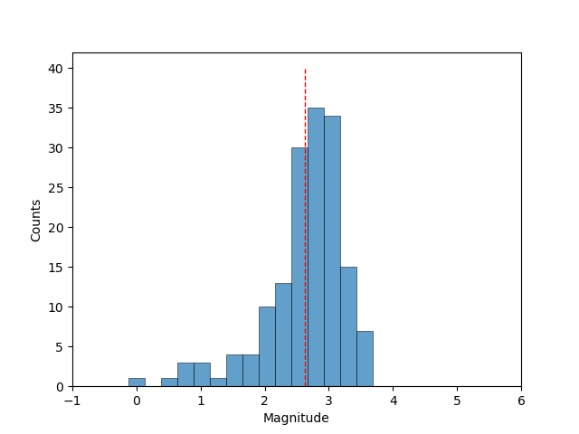
Magnitude Problem
Maximum likelihood magnitude
Inversion

Slide 62
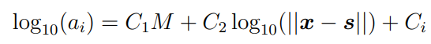
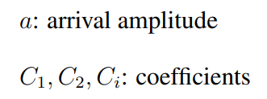
Magnitude Problem
Maximum likelihood magnitude
Inversion
Invert local magnitude scale for M, per station

Slide 63
Input Graphs
Station Graph
Magnitude Graph
m₁
m₂
m₃
m₄
m₅
m₆
M: -3 to 7, with 0.1 M increment
10-nearest-neighbors
8-nearest-neighbors

Slide 64
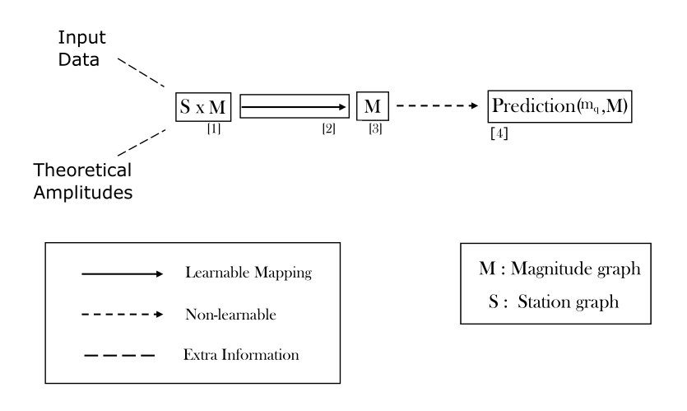
GNN: Architecture

Slide 65

GNN: Architecture
Input feature:

Slide 66

Results on Synthetic Data
Simulated many realizations
of pick data for sources (and different sets of stations)
over large spatial aperture,
with high levels of noise
GNN predicted source magnitudes
Improve upon magnitudes obtained
with traditional inversion

Slide 67
GNN: A general inverse approach
Input feature (location):
Input feature (magnitude):

Slide 68
GNN: A general inverse approach
Observed Data
Theoretical Data
Input feature (location):
Input feature (magnitude):

Slide 69
GNN: A general inverse approach
Observed Data
Theoretical Data
Input feature (location):
Input feature (misfit):
Input feature (magnitude):
• One graph to represent Data domain
• One graph to represent Model domain

Slide 70

Applications
Sun et al., 2023

Slide 71

Applications
Sun et al., 2023

Slide 72

Applications
GraphCast
Lam et al., 2023

Slide 73

Applications
Choi and Kumar, 2024

Slide 74

Applications
Choi and Kumar, 2024

Slide 75

Applications
Sanchez-Gonzalez et al., 2020

